Slide 1




Analysis of Micro-randomized Trials (with a Binary Outcome)
Daniel Almirall and Susan A. Murphy
Notes:
Mobile Health Intervention Optimization
Abstract: Mobile devices along with wearable sensors facilitate our ability to deliver supportive treatments anytime and anywhere. Indeed mobile interventions are being developed and employed across a variety of health fields, including to support HIV medication adherence, encourage physical activity and healthier eating as well as to support recovery in addictions. A critical question in the optimization of mobile health interventions is: "When and in which contexts, is it most useful to deliver treatments to the user?" This question concerns time-varying dynamic moderation by the context (location, stress, time of day, mood, ambient noise, etc.) of the effectiveness of the treatments on user behavior.
In this module:
We review a micro-randomized trial design that uses a binary outcome as the primary outcome measure and we present associated data analyses for use in examining this primary aim as well as other secondary aims. We illustrate this approach with the micro-randomized trial of JOOL, a sophisticated smart-phone based intervention to improve well-being.

Slide 2
Outline
Illustrative Example: JOOL (PI: Vic Strecher, CEO)
Throughout, this example will be used to illustrate the method.
Review the Data from a Micro-randomized Trial
Review Primary and Secondary Aims
Methodology
Results

Slide 3
Outline
JOOL (PI: Vic Strecher, CEO)
Review the Data from a Micro-randomized Trial
Review Primary and Secondary Aims in a MRT
Methodology
Results

Slide 4

JOOL (PI/CEO: Vic Strecher)
Sophisticated, smartphone-based intervention to improve well-being via purpose-driven, self-monitoring
Developed commercially
Start-up co. in Ann Arbor, MI
B2B model

Slide 5


JOOL (PI/CEO: Vic Strecher)
Conceptual Behavioral Health Model:
Sleep, Presence, Activity, Creativity and Eating (SPACE)
<=> Energy and Willpower
<=> Purpose-drive Health

Slide 6
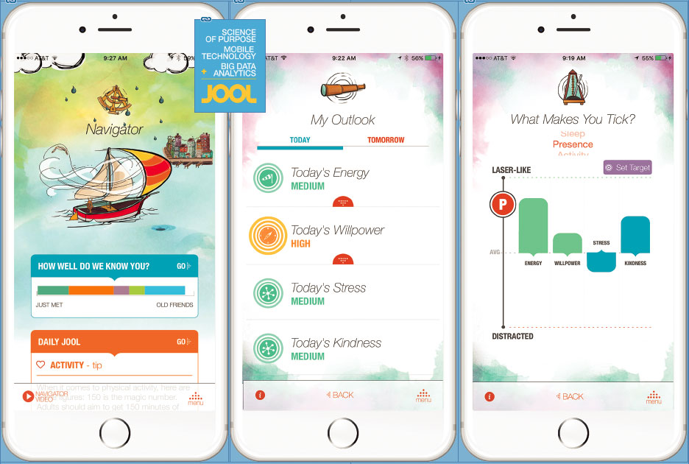
JOOL (PI/CEO: Vic Strecher)
What does the app do?
Insights about SPACE, Energy and Willpower (and other easily available or passively sensored data) via correlations and predictions
My Outlook
Daily JOOLs
What makes you tick?
…and a host of other features.

Slide 7


JOOL (PI/CEO: Vic Strecher)
Daily, self-monitoring
The more that a user engages with the app, the better the user’s experience
Users encouraged to “chart” daily
Charting does not take very long (~10 questions) but, for some, it may be difficult to stay consistent, on a daily basis

Slide 8
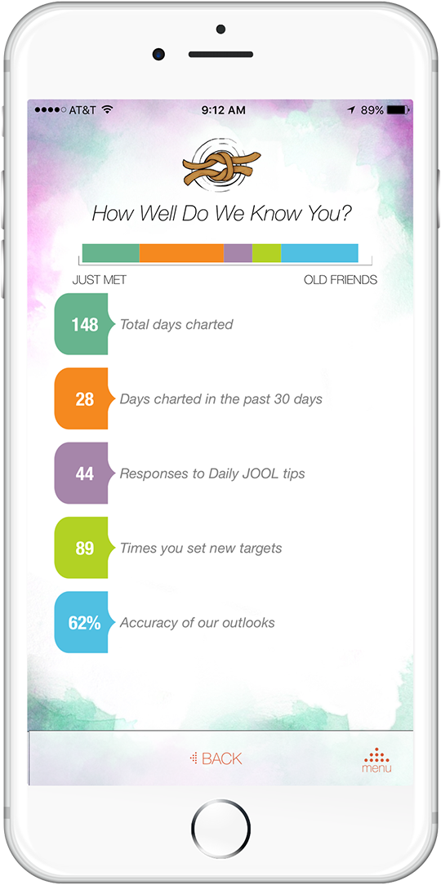
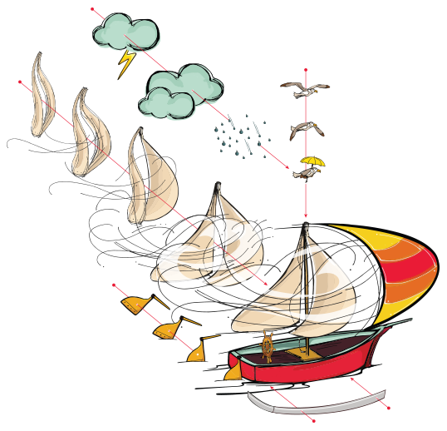
JOOL (PI/CEO: Vic Strecher)
Excellent engagement strategies
An engaging onboarding process
Core values
Purpose statement
Gamification
Dynamic boat
Unlock features as you chart
“How well do we know you?”
Customization
…and so on

Slide 9
JOOL (PI/CEO: Vic Strecher)
At the time our collaboration began
JOOL had not yet incorporated “push notifications” to encourage users to chart
This became the main interest of the micro-randomized trial.

Slide 10
Outline
JOOL (PI: Vic Strecher, CEO)
Review the JOOL Micro-randomized Trial
Review Primary and Secondary aims in JOOL MRT
Methodology
Results

Slide 11
JOOL MRT
Quality improvement MRT of n = 1255 users
T = 534 = 89*6 decision points
89 day study (3 months)
6 times per day (one selected randomly)
8:30AM, 12:30PM, 5:30PM, 6:30PM, 7:30PM, 8:30PM
Available users at the (randomly) selected time of day are randomized with equal probability (.5) to be sent or not sent a push notification containing a tailored health message

Slide 12
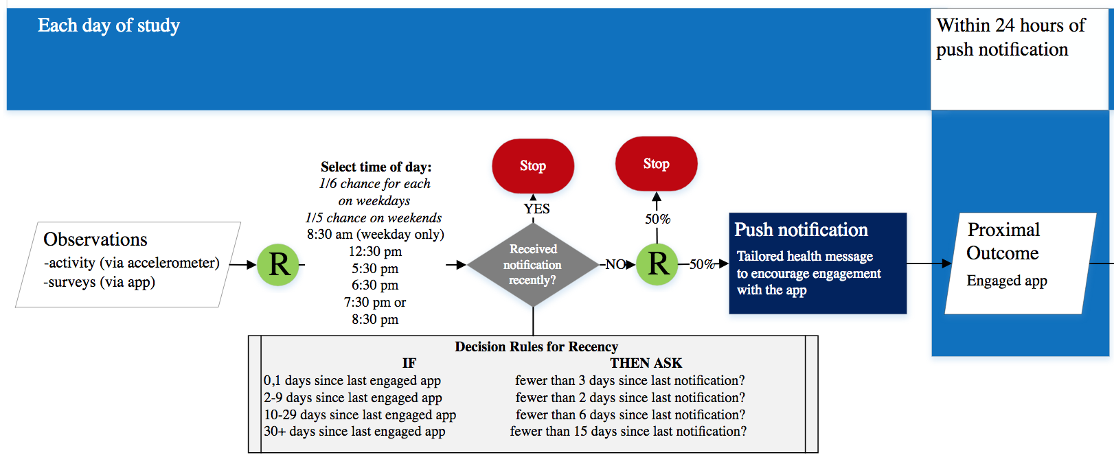
JOOL MRT, Flow

Slide 13
JOOL MRT, Availability
Mitigate risk of overburdening users with notifications
Availability based on structural constraints
At most 1 push notification per day
No push notifications before 12NOON on weekends
Availability based on recency of app use (charting)
Days since user last charted | Days to wait before available to send a push
<2 | 3
2-9 | 2
10-29 | 6
30+ | 15
Notes:
To mitigate the risk of users either turning off notifications or deleting the app due to receiving too many push notifications, the following constraints were put in place: a) on any day a user can only receive one push notification decision, b) during weekends a user can not receive a push notification decision before noon, and c) the number of days a user is considered unavailable after receiving a push notification depends on the number of days lapsed since the user's most recent engagement with the app
Note that the user could self-schedule a reminder to chart but self-scheduled reminder is not considered in the above.

Slide 14
JOOL MRT, Tailored Messages
Messages were tailored to the user’s context
Example message types:
Encourage users to unlock remaining features
Encourage users to perform specific actions (i.e., set targets, request a tip, define a purpose)
Messages relating to holidays/specific days of the year
Encourage users to think about their purpose
Provide positive feedback on recent progress made
Provide a contextually relevant, personal insight
Follow up on tips/actions users said they would try
Recommendations based on predictive models

Slide 15

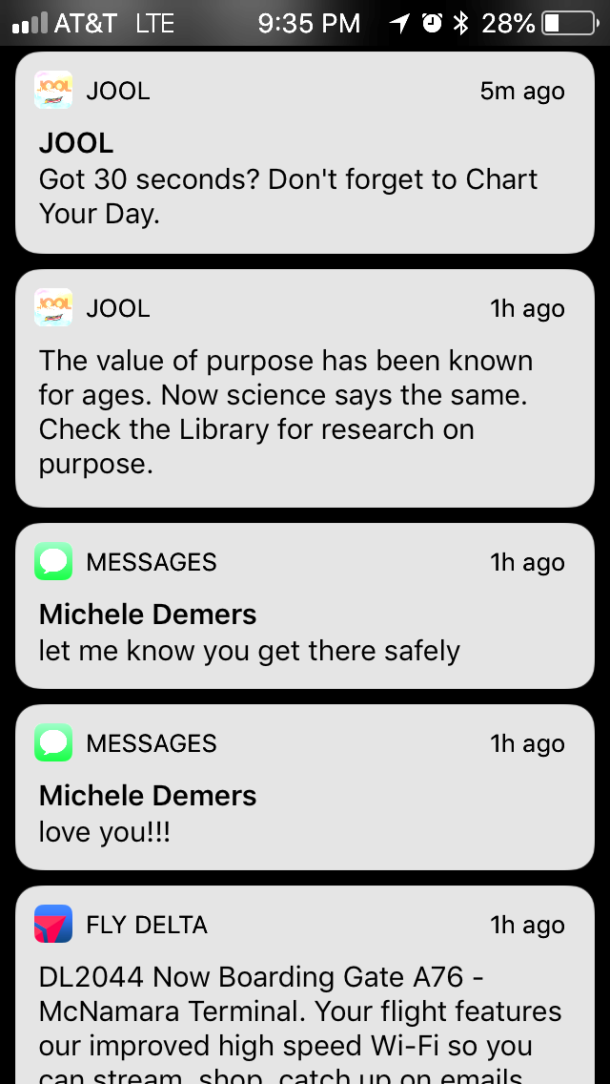
JOOL MRT, Tailored Messages
Example messages:

Slide 16
JOOL MRT, Sample Size
Conducted as a quality improvement study
Made to fit within JOOL’s business production cycle, during a 5-month window March 2017 to August 2017
As a result, there were no sample size calculation based on statistical power considerations
Notes:
To mitigate the risk of users either turning off notifications or deleting the app due to receiving too many push notifications, the following constraints were put in place: a) on any day a user can only receive one push notification decision, b) during weekends a user can not receive a push notification decision before noon, and c) the number of days a user is considered unavailable after receiving a push notification depends on the number of days lapsed since the user's most recent engagement with the app

Slide 17
Outline
JOOL (PI: Vic Strecher, CEO)
Review the JOOL Micro-randomized Trial
Primary and Secondary Aims in JOOL MRT
All of them pre-specified!!
Methodology
Results

Slide 18
JOOL MRT, Primary Aim
To test whether sending a prompt vs not sending a prompt (in moments of availability) results in an increased likelihood of user engagement (i.e., user charted at some point in the next 24 hours).
Hypothesis: We hypothesized that, on average, sending a prompt (vs not sending a prompt) will lead to greater likelihood of user engagement.
Set Type I error = 5%
Notes:
This is a marginal treatment effect with no moderators.

Slide 19
JOOL MRT, Secondary Aim 1
To test whether the effect of sending a prompt (vs not sending a prompt) on the likelihood of user engagement differs by week-in-study (there are approximately 12 weeks in the study).
Hypothesis: We hypothesized that the effect of sending a prompt will differ by week-in-study. Specifically, we hypothesize that the effect will be greater earlier in the study than later in the study, and that the effect will decrease linearly with respect to week-in-study.
Set Type I error = 10%
Notes:
This is a treatment effect conditional on week in study.

Slide 20
JOOL MRT, Secondary Aim 2
To test whether the effect of sending a prompt (vs not sending a prompt) on the likelihood of user engagement differs by weekday (Monday to Friday) vs weekend (Saturday or Sunday)?
Hypothesis: We hypothesized that the effect of sending a prompt will differ by weekday vs weekend. Specifically, we hypothesize that the effect will be greater when the prompt is made on weekends than on weekdays.
Set Type I error = 10%
Notes:
This is a treatment effect, conditional on weekend vs weekday.

Slide 21
JOOL MRT, Exploratory Aim
The treatment effect model for this was not pre-planned (and no hypotheses were given) but the general question and choice of control covariates was pre-planned!
Focused on exploring whether the effect of sending a prompt (vs not sending a prompt) on the likelihood of charting in the next 24 hours differs by time-of-day within weekday-vs-weekend.
We do not provide a hypothesis test. Only 90%CIs.

Slide 22
Outline
JOOL (PI: Vic Strecher, CEO)
Review the JOOL Micro-randomized Trial
Review Primary and Secondary Aims in JOOL MRT
Methodology
Results

Slide 23
JOOL MRT, Schematic

Slide 24
Methodology, Notation
Decision time is denoted by the pair (d, t)
d = 1, 2,…, 89 days; and t = 1, 2,…, 6 time of day
I_{d,t} = 1 if the user is available at (d, t); = 0 otherwise
B_{d,t} = 1 if push will be randomized at (d, t); = 0 o/w
I_{d,j} = 0 for times j > t after B_{d,t} = 1 (1 time-of-day rand./day)
A_{d,t} = 1 if push notification provided at (d, t); = 0 o/w
If B_{d,t} = 0 then A_{d,t} = 0, by design
H_{d,t} = all observed data up to (d, t)
Includes I_{d,t}, but excludes randomizations (B_{d,t} , A_{d,t})
Y_{d+1,t} whether (=1) or not (=0) user charts next 24hrs

Slide 25
Methodology, Notation (cont’d)
Decision time is denoted by the pair (d, t)
I_{d,t} = 1 if the user is available at (d, t); = 0 otherwise
B_{d,t} = 1 if push will be randomized at (d, t); = 0 o/w
A_{d,t} = 1 if push notification provided at (d, t); = 0 o/w
H_{d,t} = all observed data up to (d, t)
Y_{d+1,t} whether (=1) or not (=0) user charts next 24hrs
Note that a user is provided a push on (d, t) only if I_{d,t} = 1 and B_{d,t} A_{d,t} = 1

Slide 26
Methodology, Notation (cont’d)
Decision time is denoted by the pair (d, t)
I_{d,t} = 1 if the user is available at (d, t); = 0 otherwise
B_{d,t} = 1 if push will be randomized at (d, t); = 0 o/w
A_{d,t} = 1 if push notification provided at (d, t); = 0 o/w
H_{d,t} = all observed data up to (d, t)
Y_{d+1,t} whether (=1) or not (=0) user charts next 24hrs
Z_{d,t} = control covariates (subset of H_{d,t})
X_{d,t} = candidate moderators of interest (subset of Z_{d,t})
Notes:
The control covariates Z_dt in the JOOL example were pre-specified. We describe them later.
The X_dt covariates will vary depending on the scientific question/aim. We described these earlier.

Slide 27
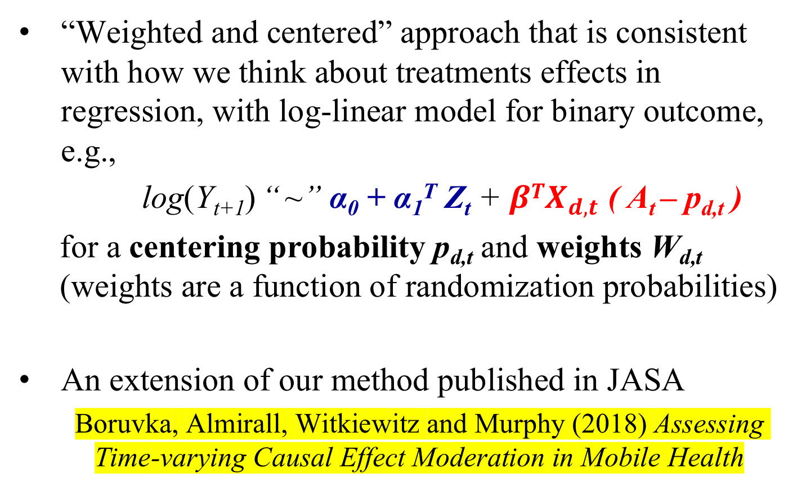
Methodology, Intuition
“Weighted and centered” approach that is consistent with how we think about treatments effects in regression, with log-linear model for binary outcome, e.g.,
log(Y_{t+1}) “ ~” α₀ + α₁^{T} Z_{t} + ${βTX}_{d,t}$ ( A_{t} – p_{d,t} )
for a centering probability p_{d,t} and weights W_{d,t} (weights are a function of randomization probabilities)
An extension of our method published in JASA
Boruvka, Almirall, Witkiewitz and Murphy (2018) Assessing Time-varying Causal Effect Moderation in Mobile Health

Slide 28
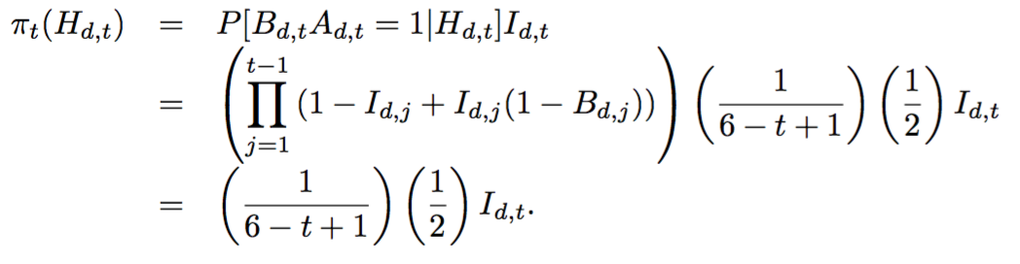

Methodology, Randomization Probabilities, $π_{t}\left(H_{t}\right)$
Recall a user is provided a push on (d, t) only if I_{d,t} = 1 and B_{d,t} A_{d,t} = 1
The push vs no push randomization probabilities (if available, i.e., if I_{d,t} = 1, are given by

Slide 29

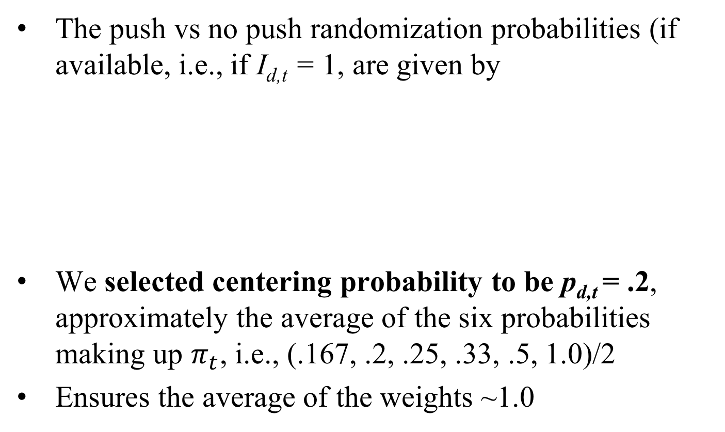
Methodology, Centering Probabilities, $p_{d,t}(X_{t})$
The push vs no push randomization probabilities (if available, i.e., if I_{d,t} = 1, are given by
We selected centering probability to be p_{d,t} = .2, approximately the average of the six probabilities making up $π_{t}$, i.e., (.167, .2, .25, .33, .5, 1.0)/2
Ensures the average of the weights ~1.0

Slide 30
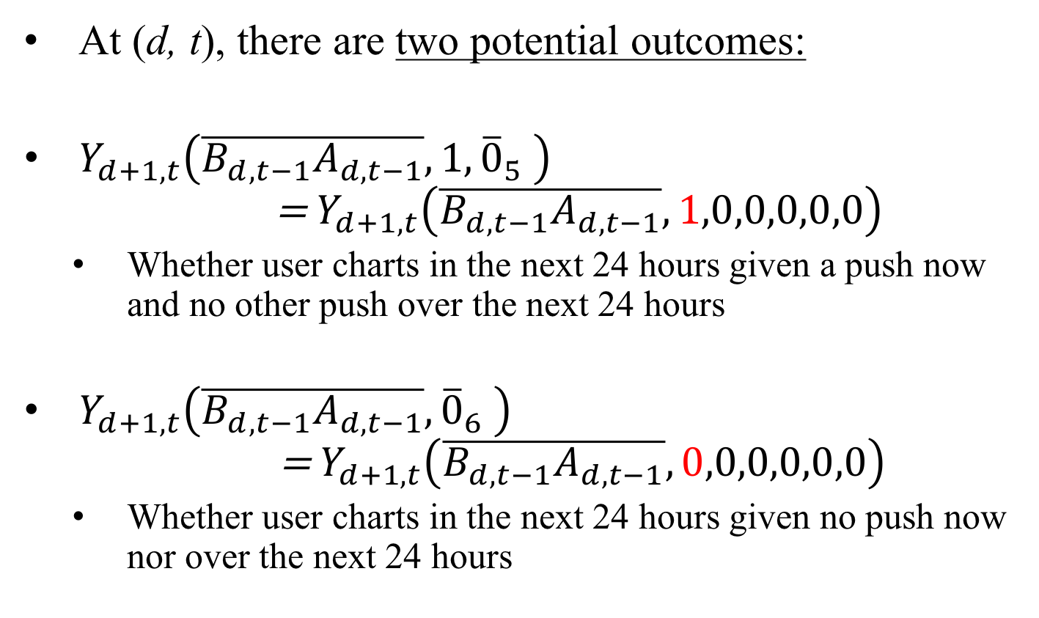
Methodology, Causal Effects
At (d, t), there are two potential outcomes:
$Y_{d+1,t}\left(\overline{B_{d,t−1}A_{d,t−1}},1,{\overline{0}}_{5} \right)$ = $Y_{d+1,t}\left(\overline{B_{d,t−1}A_{d,t−1}},1,0,0,0,0,0\right)$
Whether user charts in the next 24 hours given a push now and no other push over the next 24 hours
$Y_{d+1,t}\left(\overline{B_{d,t−1}A_{d,t−1}},{\overline{0}}_{6} \right)$ $\text{ = }Y_{d+1,t}\left(\overline{B_{d,t−1}A_{d,t−1}},0,0,0,0,0,0\right)$
Whether user charts in the next 24 hours given no push now nor over the next 24 hours

Slide 31
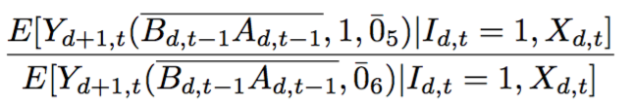
Methodology, Causal Effects
We are interested in the following causal effect:
Relative probability of charting given a push now (& no push for the next 24hrs) versus the probability of charting given no push now (nor over the next 24hrs)
Conditional on X_{d,t} and being available, I_{d,t} = 1
Causal effect is on the “risk” ratio scale
A value >1 indicates the push is effective given X_{d,t}

Slide 32
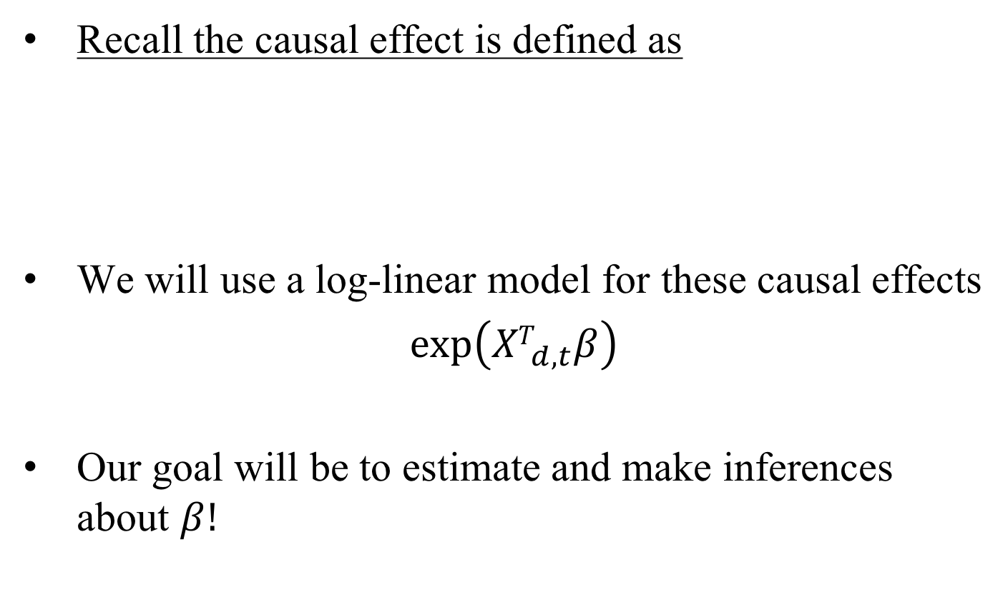
Methodology, Causal Modeling
Recall the causal effect is defined as
We will use a log-linear model for these causal effects
$\exp\left({XT}_{d,t}β\right)$
Our goal will be to estimate and make inferences about $β!$

Slide 33
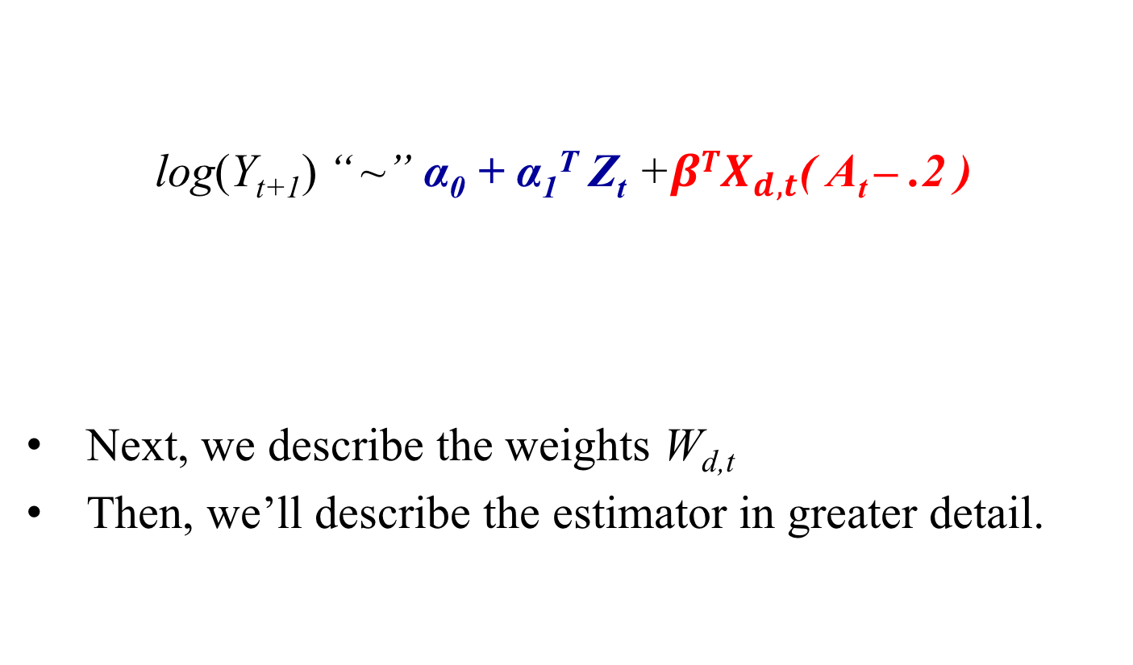
Methodology, Log-linear Regression
log(Y_{t+1}) “ ~” α₀ + α₁^{T} Z_{t} +${βTX}_{d,t}$( A_{t} – .2 )
Next, we describe the weights W_{d,t}
Then, we’ll describe the estimator in greater detail.
W_{d,t}

Slide 34
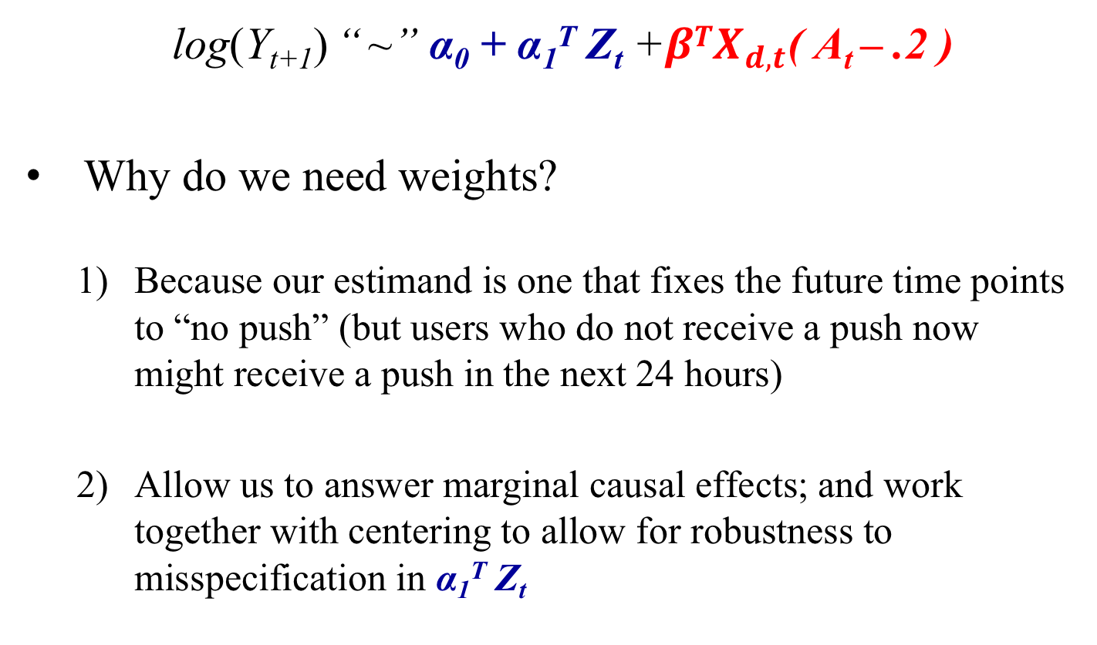
Methodology, Weights
W_{d,t}
log(Y_{t+1}) “ ~” α₀ + α₁^{T} Z_{t} +${βTX}_{d,t}$( A_{t} – .2 )
Why do we need weights?
Because our estimand is one that fixes the future time points to “no push” (but users who do not receive a push now might receive a push in the next 24 hours)
Allow us to answer marginal causal effects; and work together with centering to allow for robustness to misspecification in α₁^{T} Z_{t}
Notes:
By design, all users who receive a push at decision point (d,t) will not receive another push in the next 24 hours.
However, this is not true of users who do not receive a push at (d, t); these users may or may not receive a push over the next 24 hours.

Slide 35
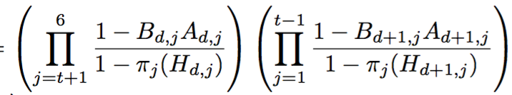
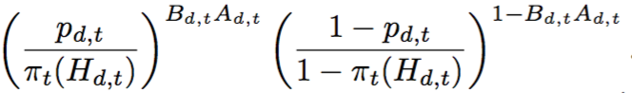
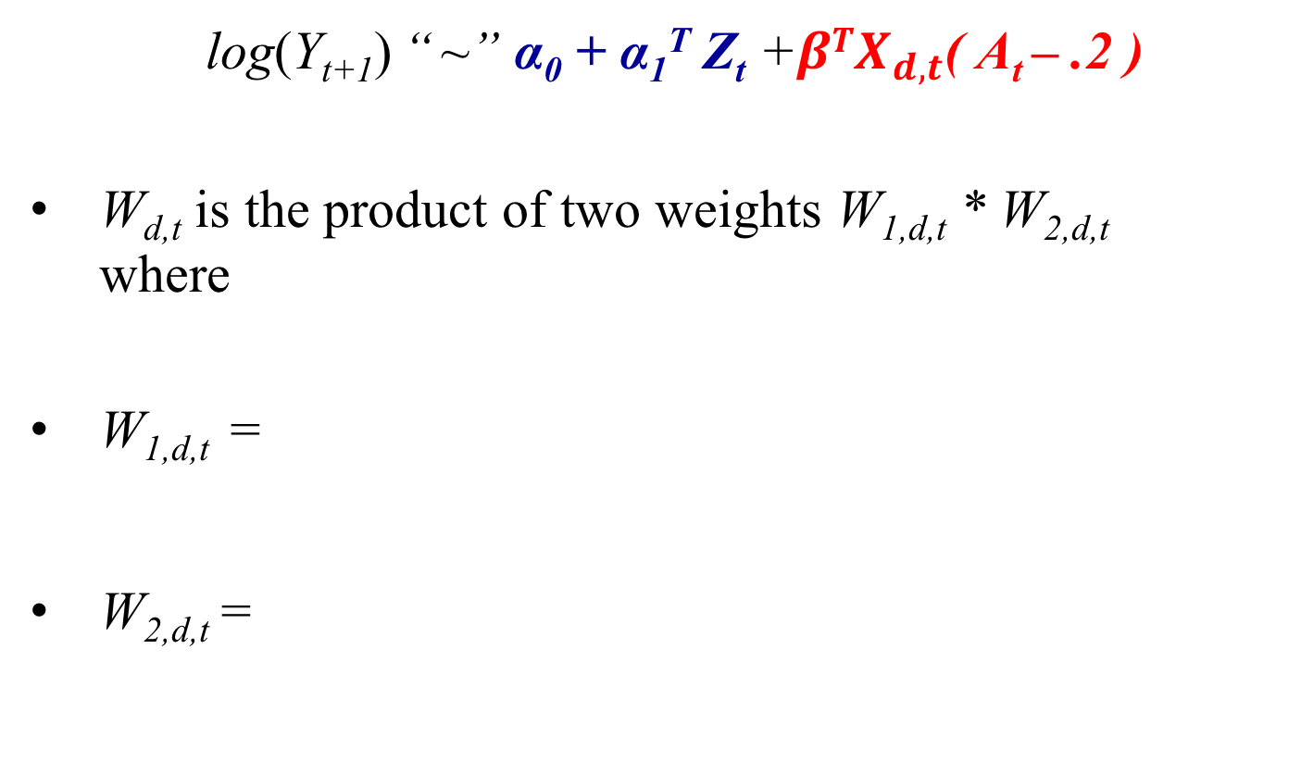
Methodology, Weights
W_{d,t}
log(Y_{t+1}) “ ~” α₀ + α₁^{T} Z_{t} +${βTX}_{d,t}$( A_{t} – .2 )
W_{d,t} is the product of two weights W_{1,d,t} * W_{2,d,t} where
W_{1,d,t} =
W_{2,d,t} =
Notes:
Intuitively, the numerator of the weights W_1,d,t subset the data so that only users who do not receive a push in the next 24 hours are used in estimation.
The denominator of W_1,d,t is used to account for the fact that such users may be different from users who do receive a push over the next 24 hours.
As before, the weights W_2,d,t allow us to examine causal effects that are marginal over measures in H_d,t that are not in X_d,t.

Slide 36
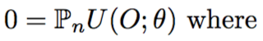
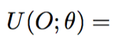
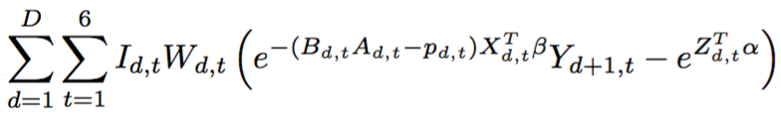
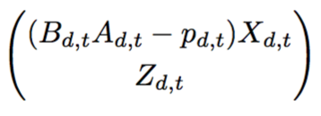
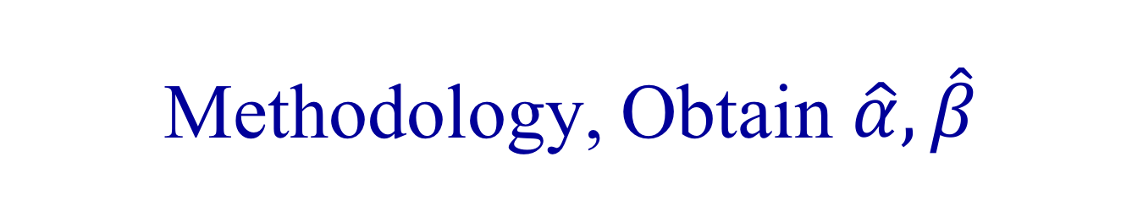
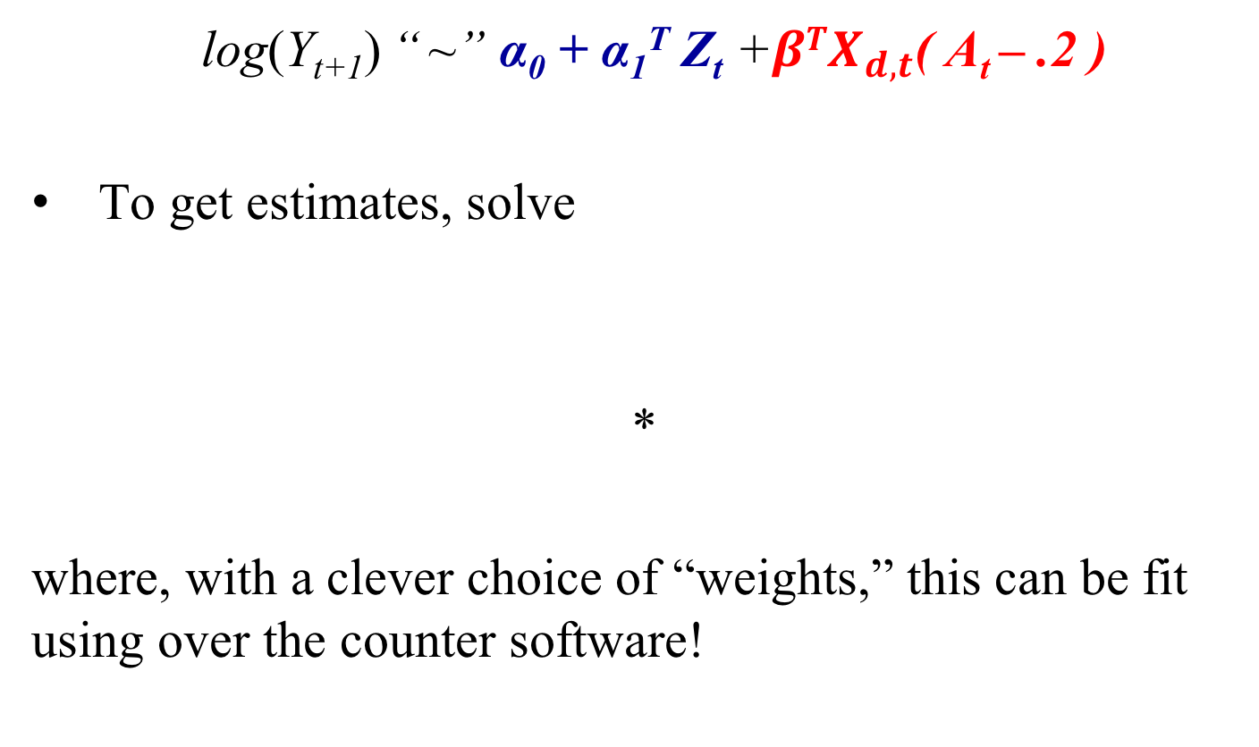
Methodology, Obtain $\hat{α},\hat{β}$
W_{d,t}
log(Y_{t+1}) “ ~” α₀ + α₁^{T} Z_{t} +${βTX}_{d,t}$( A_{t} – .2 )
To get estimates, solve
*
where, with a clever choice of “weights,” this can be fit using over the counter software!
Notes:
What is remarkable about this estimating equation, is that it can be re-written such that, with a clever choice of “weights”, it can be fit using over the counter log-linear modeling software.
This means no special software is needed for obtaining the \hat{\beta}.

Slide 37
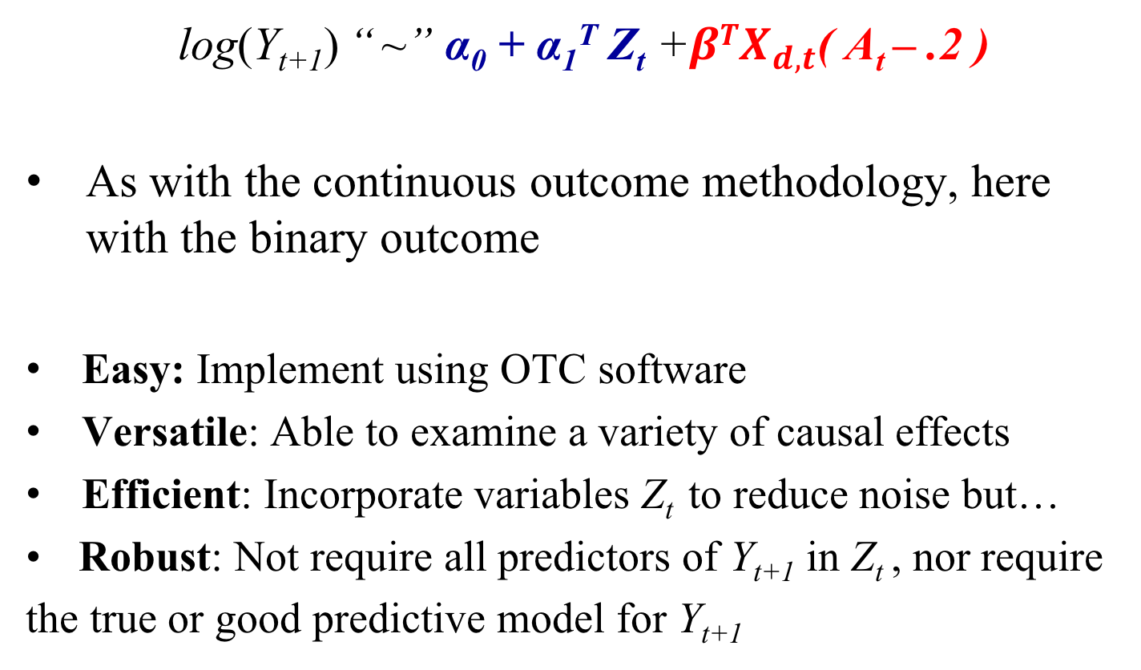
Methodology, Properties
W_{d,t}
log(Y_{t+1}) “ ~” α₀ + α₁^{T} Z_{t} +${βTX}_{d,t}$( A_{t} – .2 )
As with the continuous outcome methodology, here with the binary outcome
Easy: Implement using OTC software
Versatile: Able to examine a variety of causal effects
Efficient: Incorporate variables Z_{t} to reduce noise but…
Robust: Not require all predictors of Y_{t+1} in Z_{t} , nor require the true or good predictive model for Y_{t+1}
Notes:
The method has these 4 properties.
Note, IMPORTANT: We are not modeling the conditional distribution of Y_t+1 given the past. The only modeling assumption we make is concerning the causal effects (the red part of the fit).

Slide 38
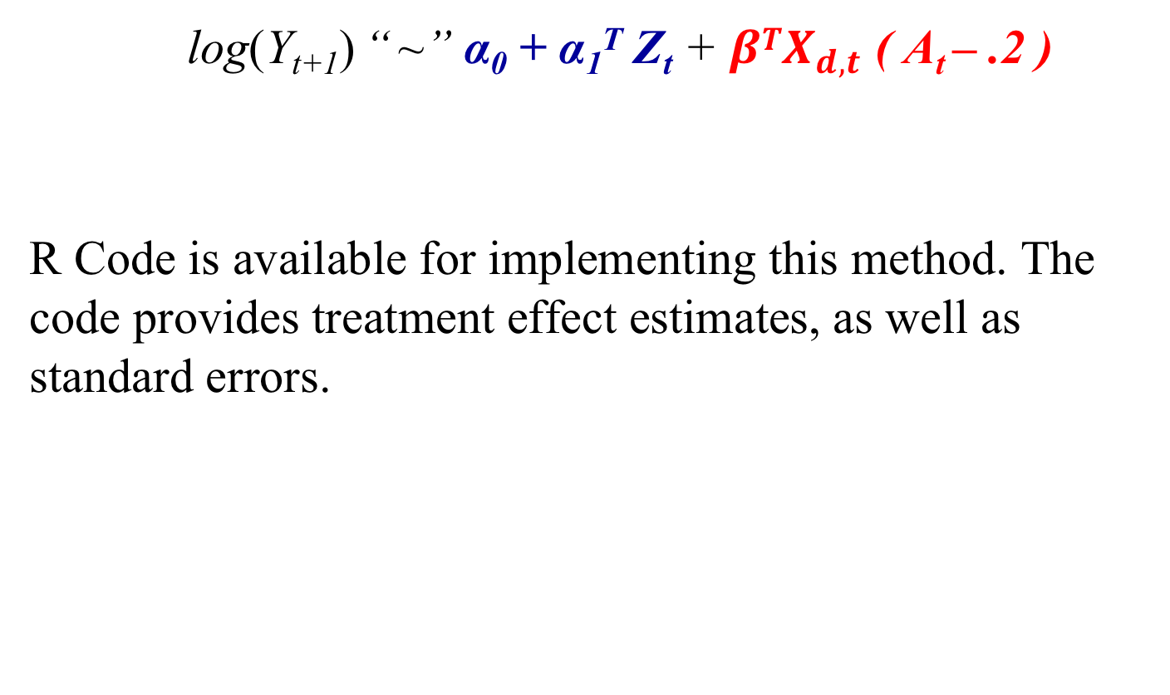
Methodology, Implementation
W_{d,t}
log(Y_{t+1}) “ ~” α₀ + α₁^{T} Z_{t} + ${βTX}_{d,t}$ ( A_{t} – .2 )
R Code is available for implementing this method. The code provides treatment effect estimates, as well as standard errors.

Slide 39
Outline
JOOL (PI: Vic Strecher, CEO)
Review the JOOL Micro-randomized Trial
Review Primary and Secondary aims in JOOL MRT
Methodology
Results

Slide 40
JOOL MRT, Sample Descriptives
Gender
64%, female
Age
29%, <30 years old
42%, 30-50 years old
29%, >50 years old
BMI
53%, overweight or obese

Slide 41
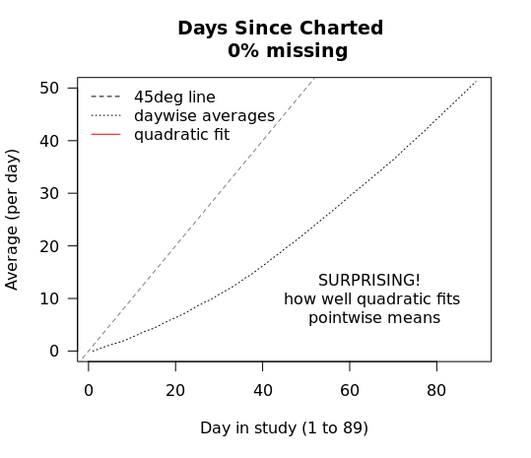
JOOL MRT, Control-covariates Z_{t}
Days since charted

Slide 42
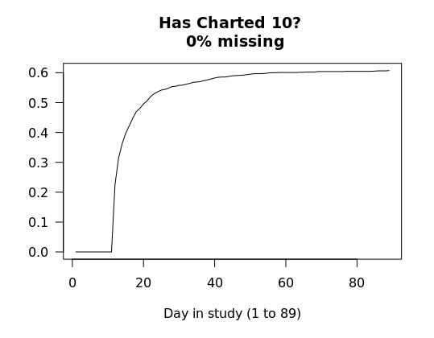
JOOL MRT, Control-covariates Z_{t}
Has charted 10?

Slide 43
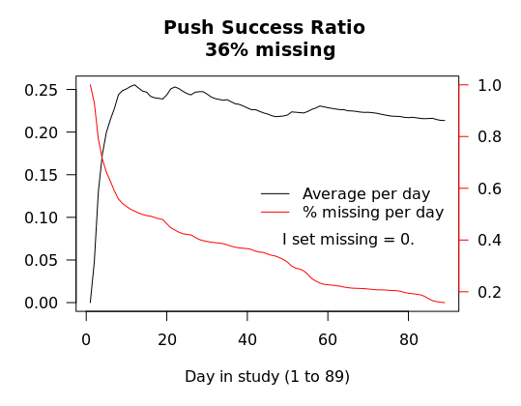
JOOL MRT, Control-covariates Z_{t}
Push Success Ratio (and Whether Pushed)

Slide 44
JOOL MRT, Time-of-day Randzs. Anecdote: Data Management Error
Time of day randomizations appeared to have an error:
Time of Day | Estimated Cumulative Percent Selected given Available | Expected Cumulative Percent Selected given Available
8:30AM | 11.8 | 16.7 (1/6)
12:30PM | 19.6 | 20.0 (1/5)
5:30PM | 24.7 | 25.0 (1/4)
6:30PM | 33.5 | 33.3 (1/3)
7:30PM | 49.4 | 50.0 (1/2)
8:30PM | 100.00 | 100.00 (1/1)
Notes:
The result for 8:30AM was not consistent with the planned time of day randomization. The time of day randomizations were planned to be
1/6, 1/5, 1/4, 1/3, 1/2, 1
at 8:30AM, 12:30PM, 5:30PM, 6:30PM, 7:30PM and 8:30P1M, respectively.
We discovered an error in the data set, which caused this inconsistency. In the data, availability (I) was supposed to be set to 0 for 8:30AM on all weekend days, but it had not been set to zero. When we re-set all I=0 for 8:30AM on all weekend days, the results were as follows and according to the planned randomizations:
16.196 19.858 24.766 33.524 49.365 100.000

Slide 45
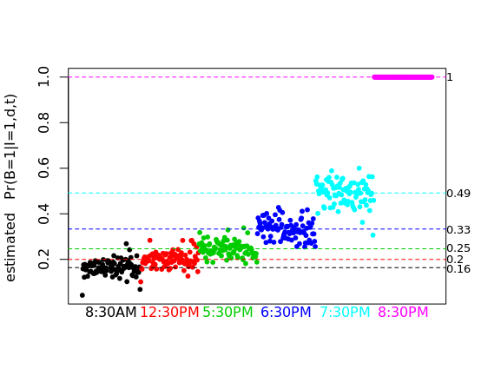
JOOL MRT, Time-of-day Randzs.
Time of day randomizations given I_{d,t} = 1 :

Slide 46
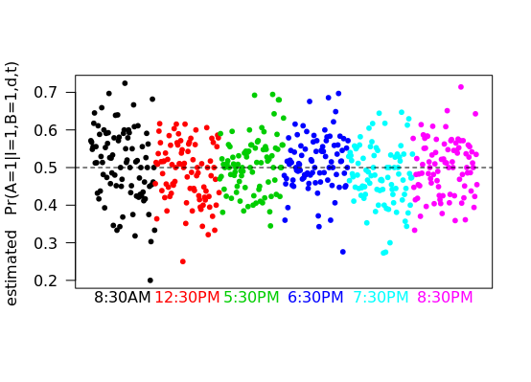
JOOL MRT, Push Randomizations
Push randomizations given time-of-day and I_{d,t} = 1 :

Slide 47
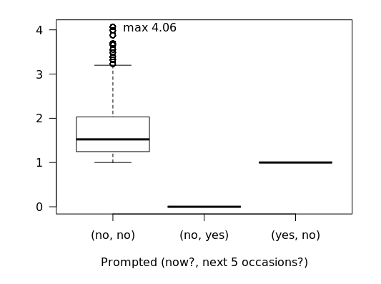
JOOL MRT, Weights
Distribution of the W_{1,d,t} given I_{d,t} = 1 by push pattern:
Notes:
The x-axis on this graph could be thought of as representing three different “excursions”.

Slide 48
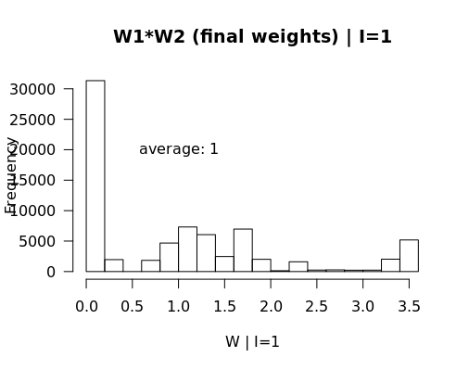
JOOL MRT, Weights
Distribution of the W_{d,t} (final) given I_{d,t} = 1 :

Slide 49
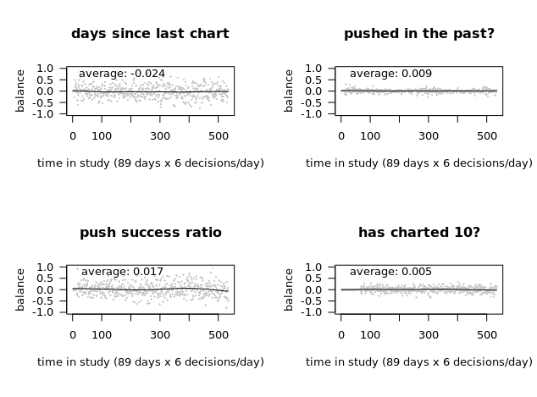
JOOL MRT, Balance
Examining balance between push vs no push on Z_{t} :
Notes:
At each time point, the covariate history H_t is balanced for “any possible excursions taken in the future”.
Here, we show the balance on our 4 key covariates that make up Z_t.
We want and expect the curves to estimate zero – indicating balance in the distribution of Z_t.

Slide 50
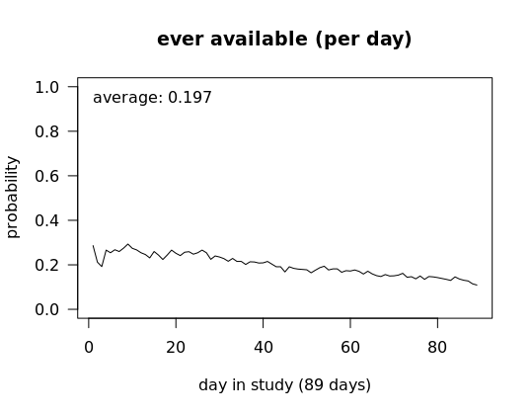
JOOL MRT, Availability by day
Notes:
In JOOL, availability decreased slightly over time.

Slide 51
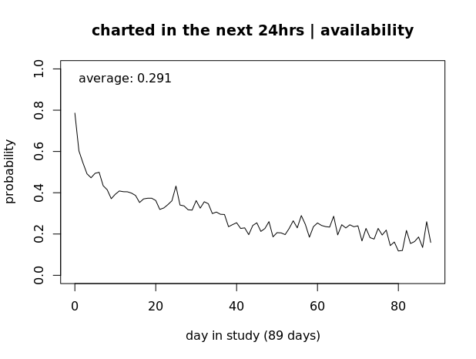
JOOL MRT, Charted | available
Notes:
Charting decreases from t=0 but, unlike in other areas, the rate of engagement (charting) does not seem to approach zero in JOOL. Rather, it averages out near 0.2 in the long-term.
On average over the course of three months, individuals are engaged 30% of the time.

Slide 52
JOOL, Primary Aim Results
To test whether sending a prompt vs not sending a prompt (in moments of availability) results in an increased likelihood of user engagement (i.e., user charted at some point in the next 24 hours).
Hypothesis: We hypothesized that, on average, sending a prompt (vs not sending a prompt) will lead to greater likelihood of user engagement.

Slide 53
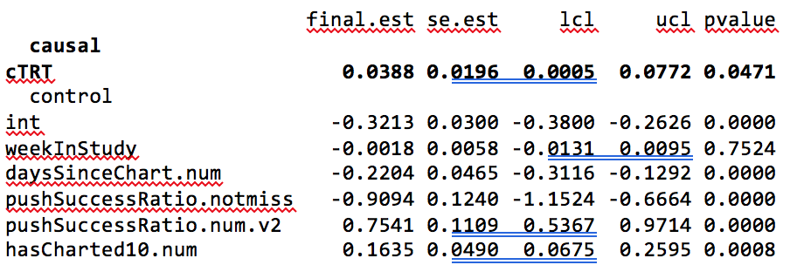
JOOL, Primary Aim Results
Individuals are exp(0.0388) = 1.039 times as likely (i.e., 3.9% as likely; p<.05) to chart in the next 24 hours when prompted vs when not prompted (95%CI, 1.01 to 1.08)

Slide 54
JOOL, Secondary Aim 1 Results
To test whether the effect of sending a prompt (vs not sending a prompt) on the likelihood of user engagement differs by week-in-study (there are approximately 12 weeks in the study).
Hypothesis: We hypothesized that the effect of sending a prompt will differ by week-in-study. Specifically, we hypothesize that the effect will be greater earlier in the study than later in the study, and that the effect will decrease linearly with respect to week-in-study.

Slide 55
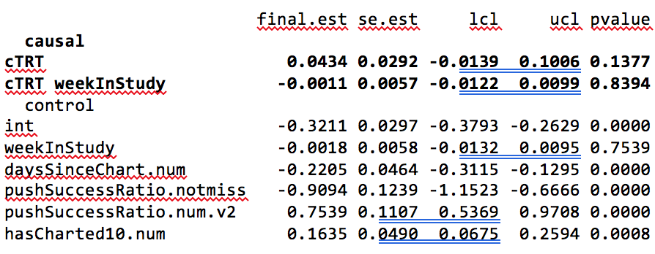
JOOL, Secondary Aim 1 Results
Insufficient evidence to reject the null that the effect of prompting vs not prompting does not differ by week in study (p = 0.84)

Slide 56
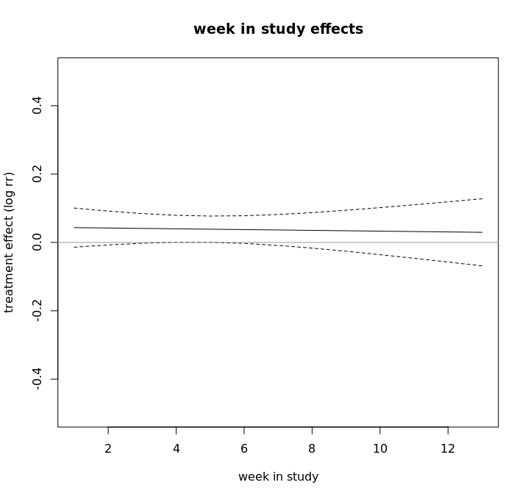
JOOL, Secondary Aim 1 Results
Insufficient evidence to reject the null that the effect of prompting vs not prompting does not differ by week in study (p = 0.84)

Slide 57
JOOL, Secondary Aim 2 Results
To test whether the effect of sending a prompt (vs not sending a prompt) on the likelihood of user engagement differs by weekday (Monday to Friday) vs weekend (Saturday or Sunday)?
Hypothesis: We hypothesized that the effect of sending a prompt will differ by weekday vs weekend. Specifically, we hypothesize that the effect will be greater when the prompt is made on weekends than on weekdays.

Slide 58
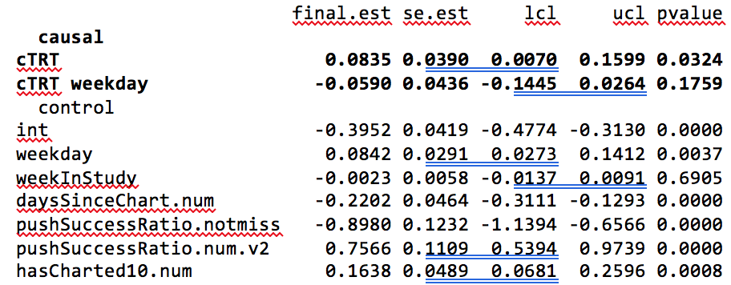
JOOL, Secondary Aim 2 Results
Insufficient evidence to reject the null that weekend & weekday effects do not differ from each other (p = 0.18).

Slide 59
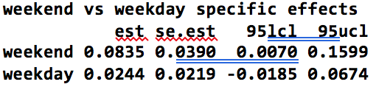
JOOL, Secondary Aim 2 Results
Effect of prompting vs not prompting is estimated to be somewhat larger on weekends than on weekdays.

Slide 60
JOOL, Exploratory Aim Results
The treatment effect model for this was not pre-planned (and no hypotheses were given) but the general question and choice of control covariates was pre-planned!
Focused on exploring whether the effect of sending a prompt (vs not sending a prompt) on the likelihood of charting in the next 24 hours differs by time-of-day within weekday-vs-weekend.

Slide 61
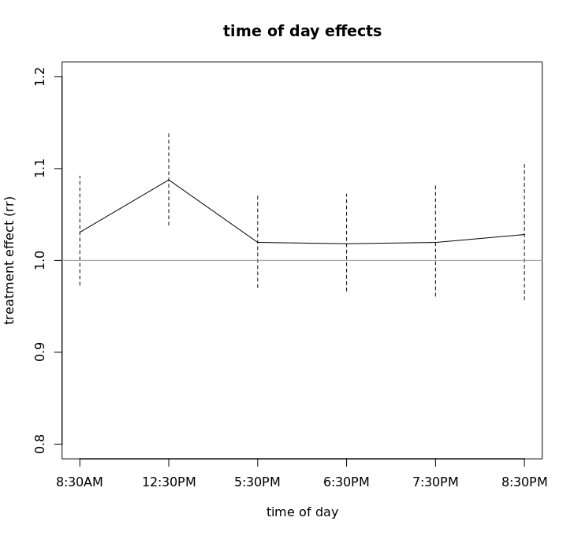
JOOL, Exploratory Aim Results
Part a): We looked across time of day only

Slide 62
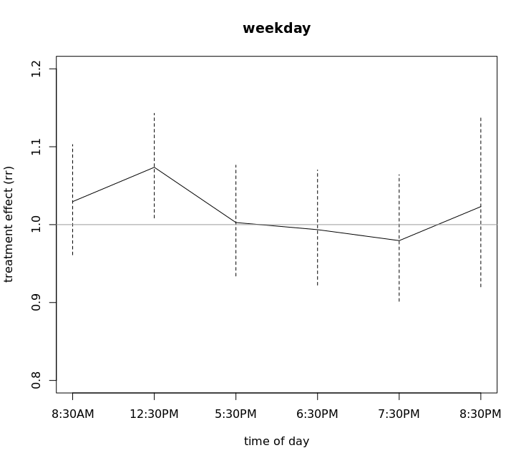
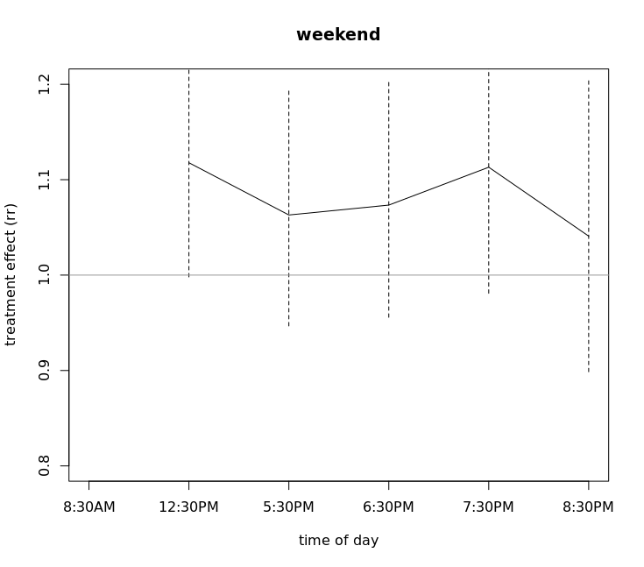
JOOL, Exploratory Aim Results
Part b): We looked by time of day and weekend/weekday

Slide 63



Thank you!!
Collaborators
and the JOOL Health Team!

